Slide 1
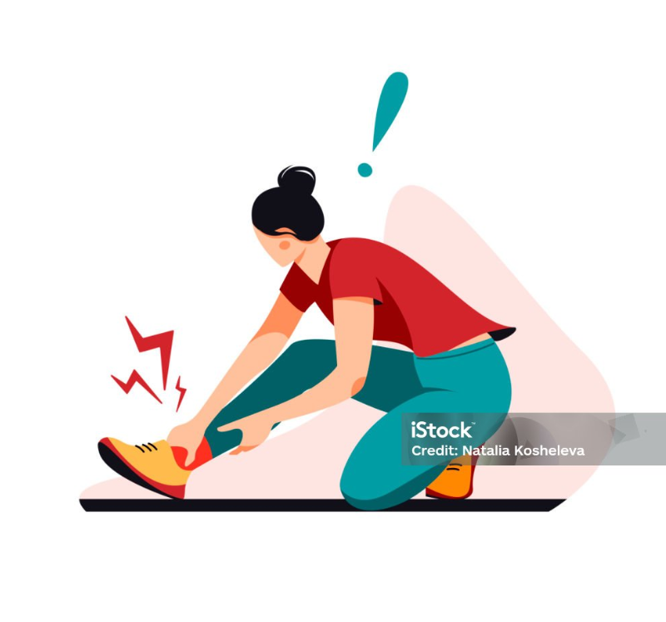

Adult Basic Life Support (BLS) and Emergency First Aid
Clare Watt RGN RCUK Instructor

Slide 2
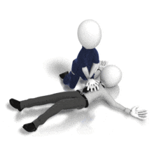
Agenda
Part 1 – Education:
Sprains and Strains
Bleeding
Allergic Reaction
Hypothermia
Part 2 – Practical:
Choking
Adult Resuscitation
Using an AED on an Adult
Recovery Position

Slide 3
Prioritising Treatment – First Aid
Aims of First Aid:
Preserve Life
Prevent the Situation Worsening
Promote Recovery
Consider the following:
Assessing the situation as safe to approach
Protection from danger – for yourself and others
Getting help from all necessary services – Ambulance, Police and Fire Services
Reporting and Recording where necessary

Slide 4
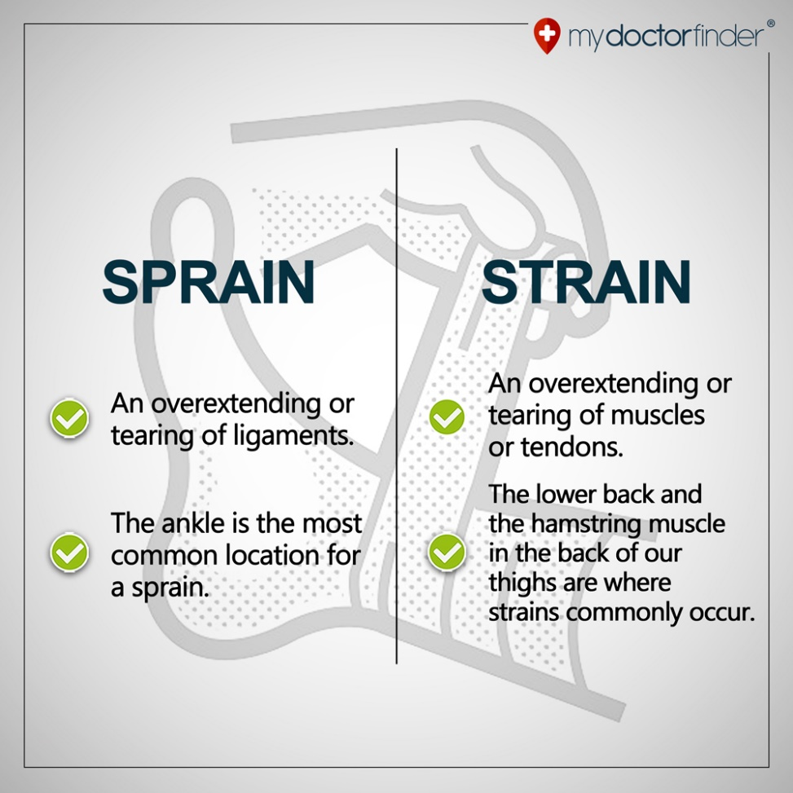
Sprains, Strains and Fractures
Common Causes of Sprains and Strains:
Exercising without warming up properly
Using athletic equipment that does not fit properly
Exercising when bones or muscles are fatigued
Signs of a Fracture:
Pain and Tenderness
Loss of Power
Unnatural movement
Swelling or bruising
Deformity (bone is bent in the wrong place)
Irregularity (skin depressions)
Crepitus - grinding

Slide 5
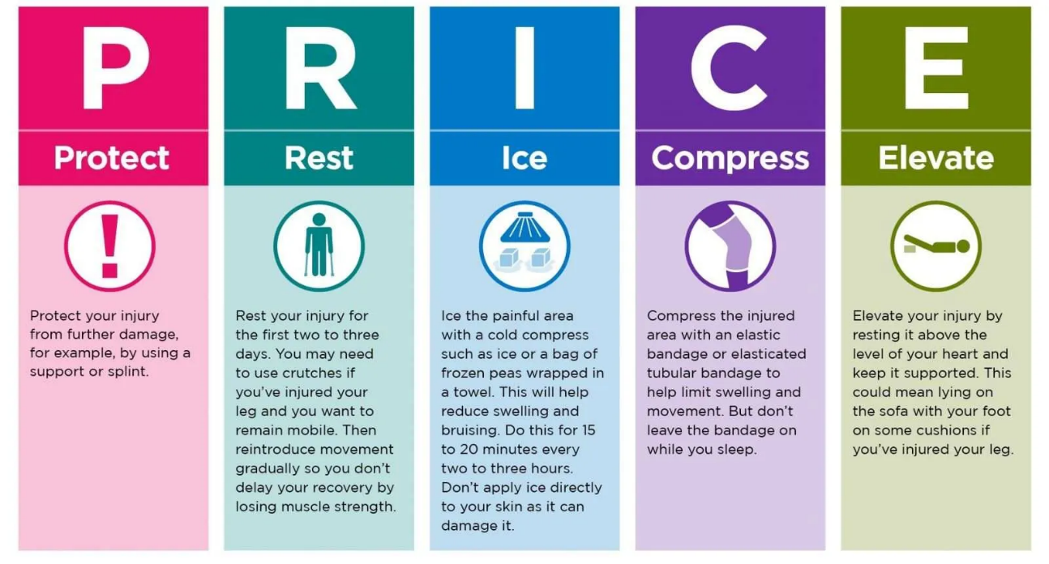
PRICE

Slide 6
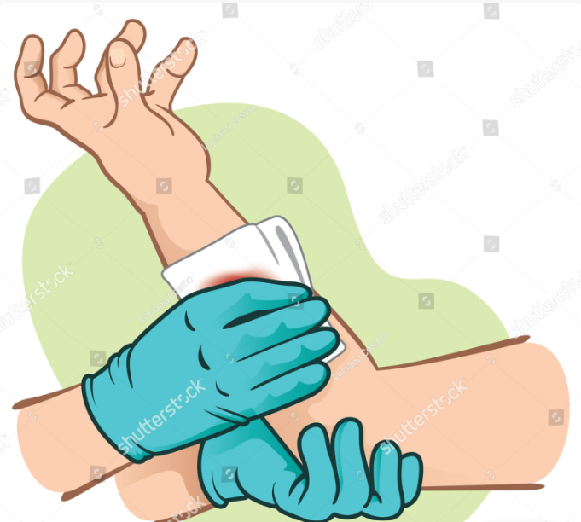
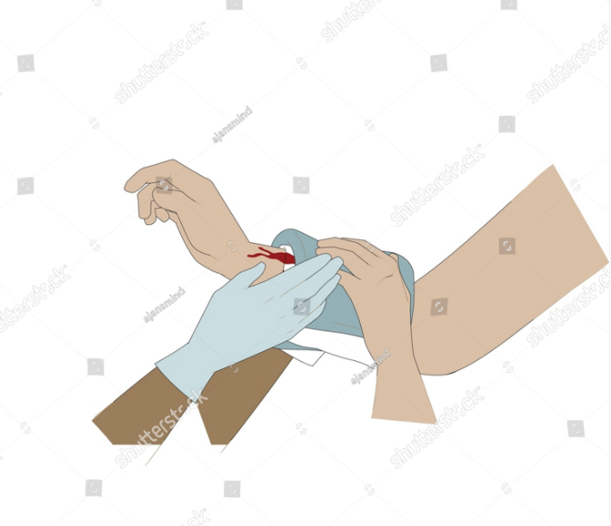
Controlling External Bleeding
Direct Pressure:
Apply direct pressure to the wound site with your gloved hand
Apply firm pressure with a sterile dressing or clean cloth
Apply pressure until bleeding is controlled, (this could take 10 – 30 minutes or longer)
Hold dressing in place with bandages after bleeding is controlled
Never remove a dressing once in place
Considerations:
Caution with embedded objects
Call for emergency help with excessive bleeding
Using a Tourniquet – must be above the wound and note the time

Slide 7
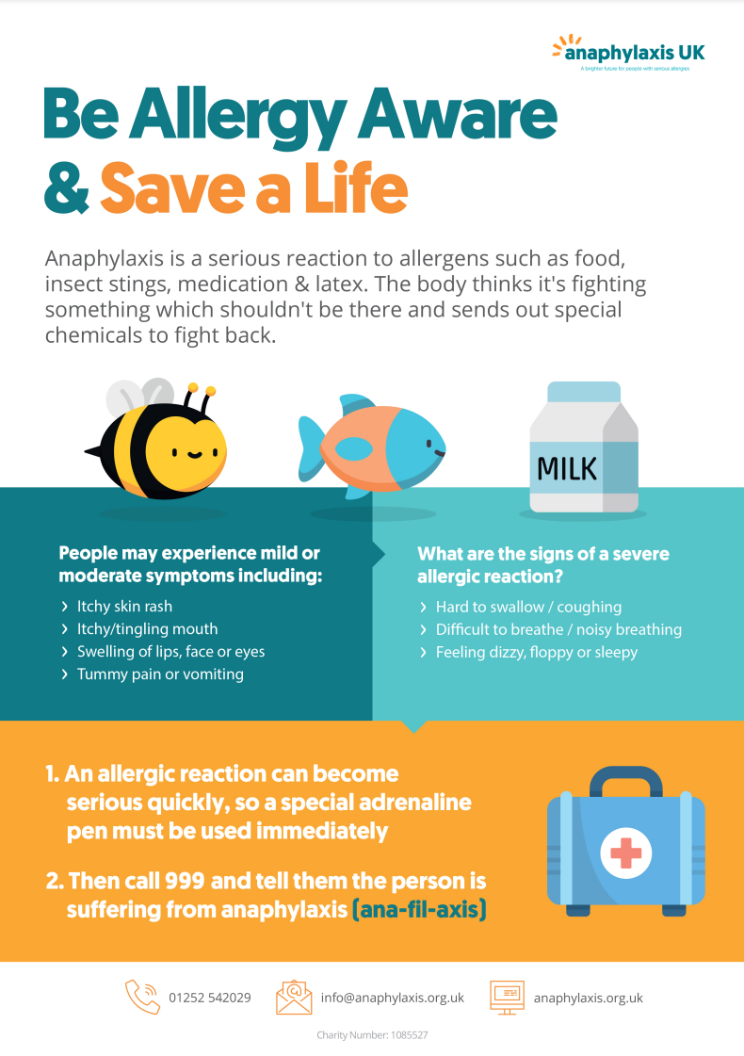
Allergic Reactions
Look out for ABC:
Airway
Persistent cough
Vocal Changes
Difficulty swallowing
Swollen Tongue
Breathing
Difficulty or noise breathing
Wheezing
Consciousness/Circulation
Clammy skin
Confusion
Feeling Lightheaded
Unresponsive or unconscious

Slide 8
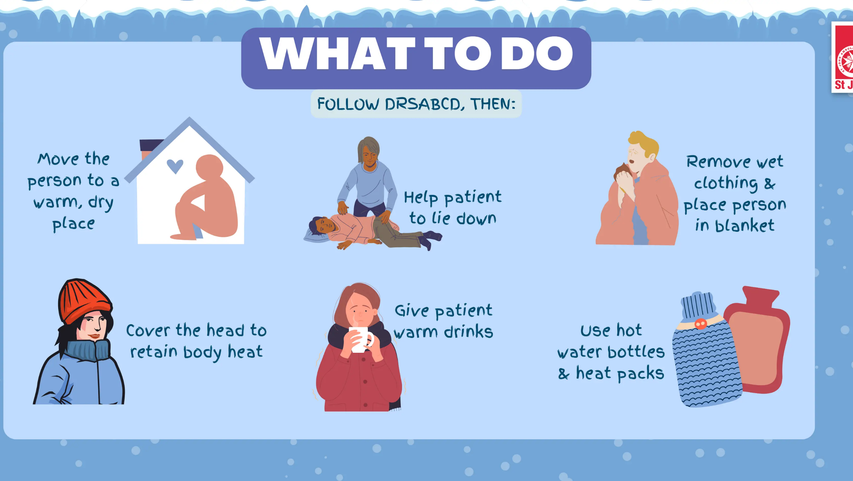
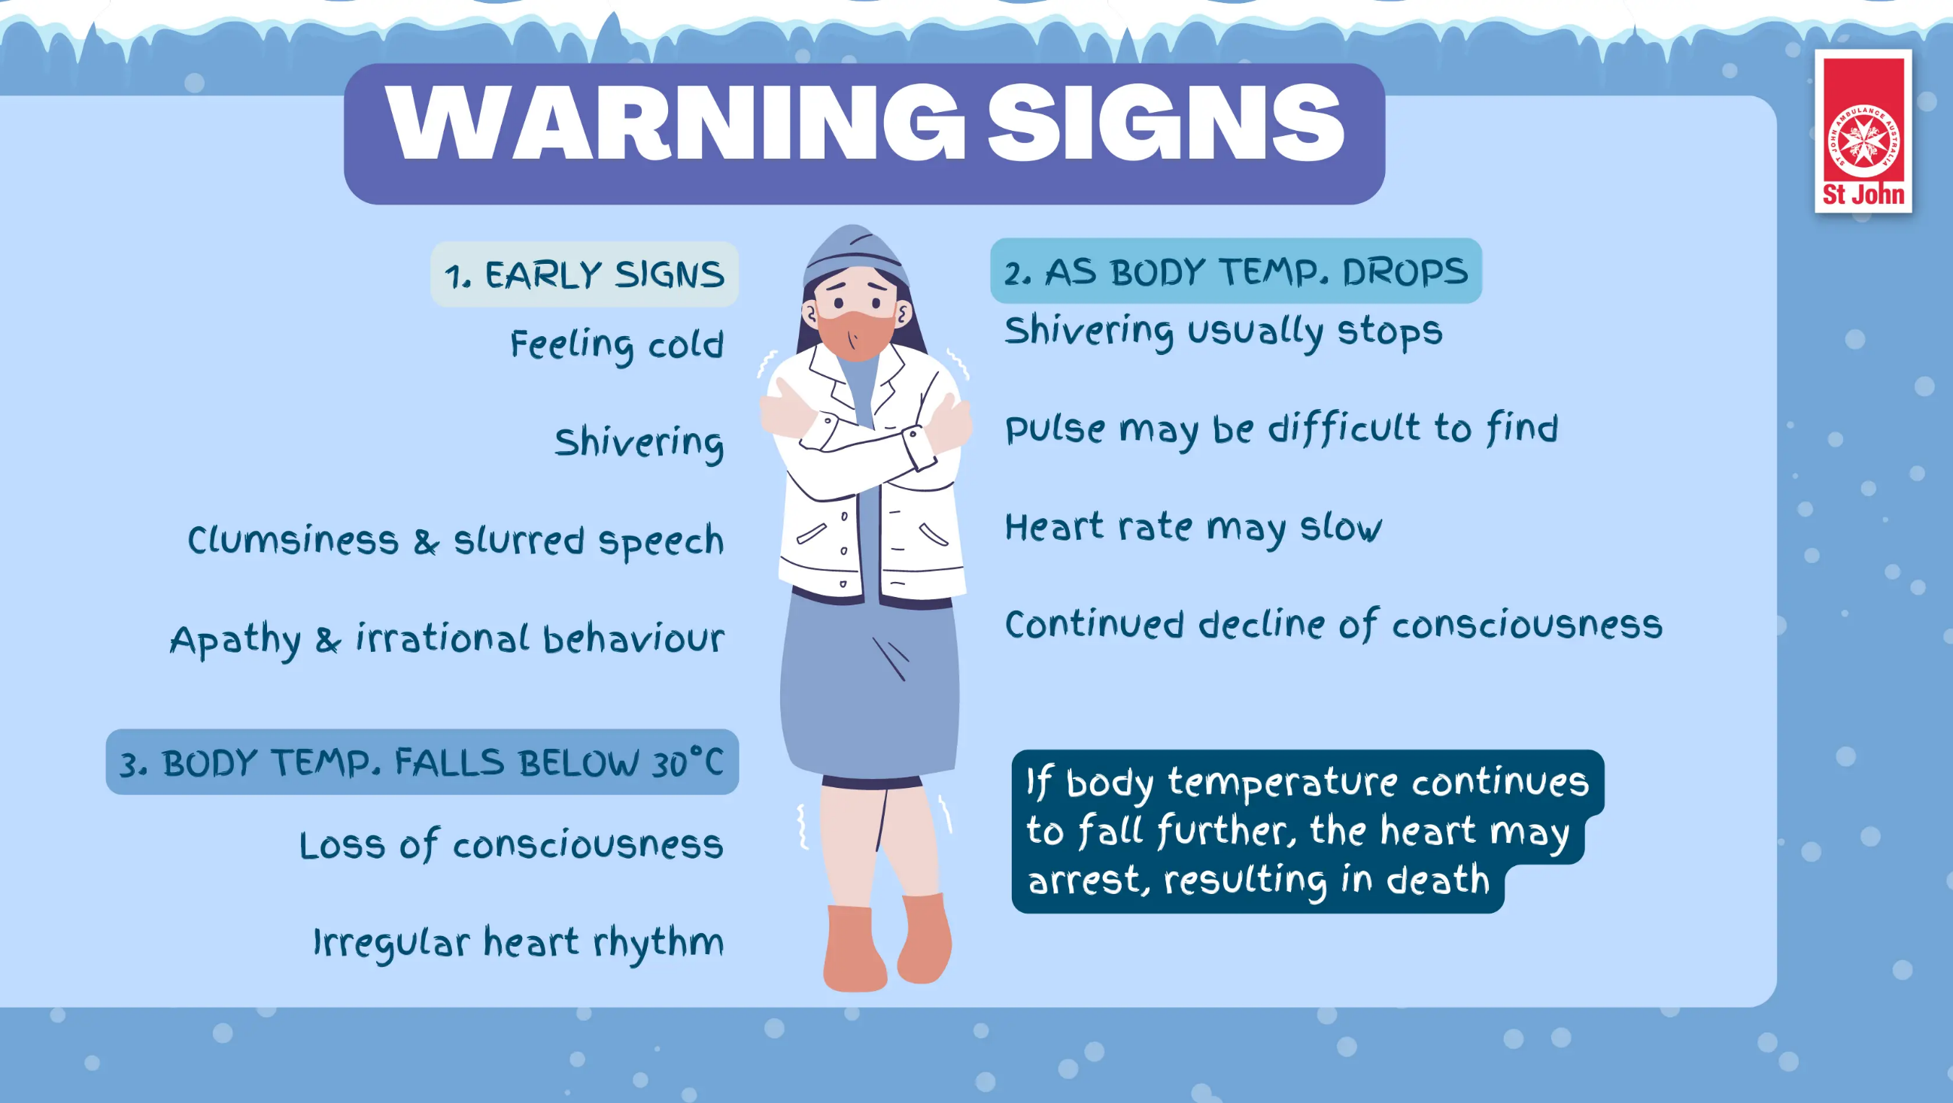
Hypothermia

Slide 9
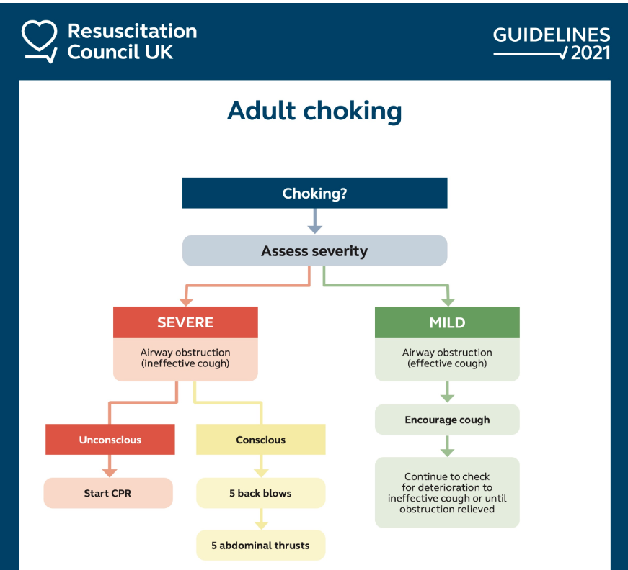
Choking
This can be a life-threatening medical emergency when food or an object becomes lodged in a person's airway, causing obstruction to their lungs.
Choking can lead to unconsciousness or even Cardiopulmonary arrest if the obstruction is severe enough.
Quick recognition and proper management of a casualty who is choking is of key importance

Slide 10
End of Part 1 – Any questions?

Slide 11
Part 2
What we will be focusing on:
Initial Patient Assessment – What is their level of Responsiveness?
Confirmation of Cardiac Arrest
How to get help
Adult Basic Life Support - Algorithm
Adult Basic Life Support – Practical
AED
Recovery Position
How your phone can help you

Slide 12
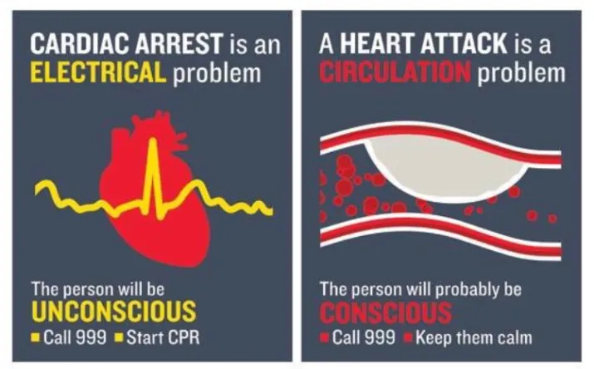
Cardiac Arrest

Slide 13
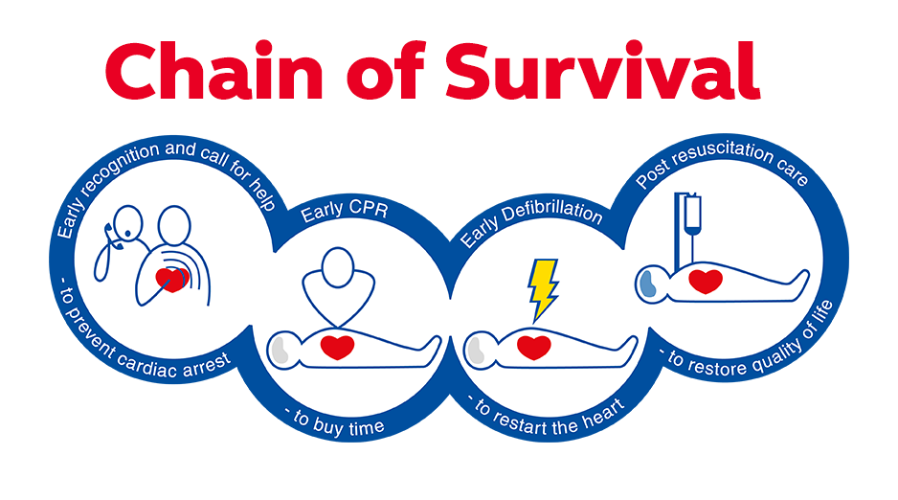

Slide 14
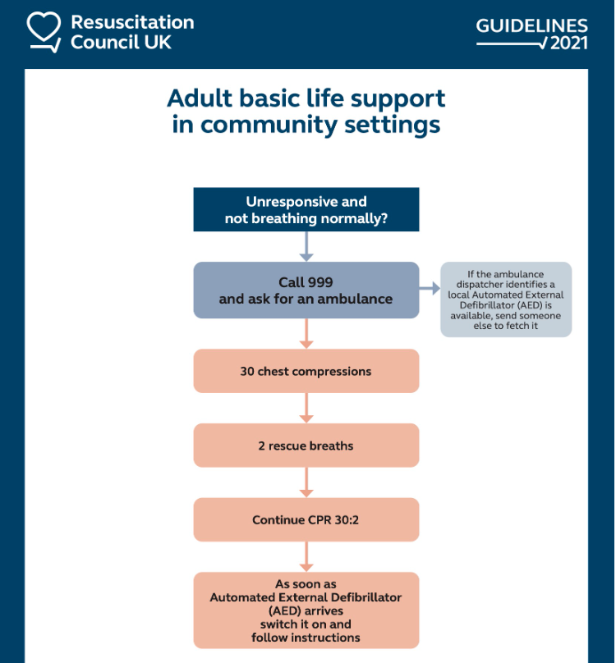

Slide 15
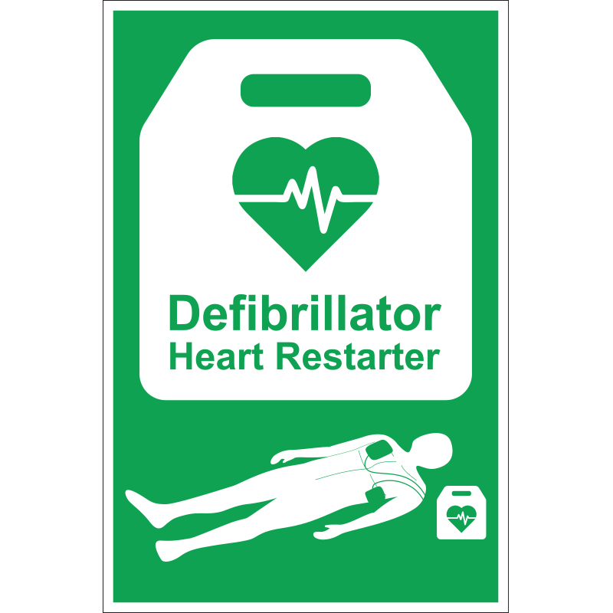
Automated External Defibrillator
(AED)
Switch on voice prompts.
Consider your pad position.
Safety of yourself and others around you.

Slide 16
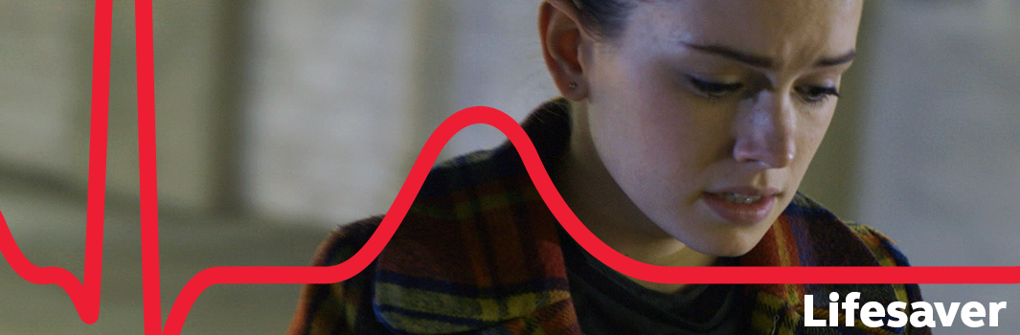
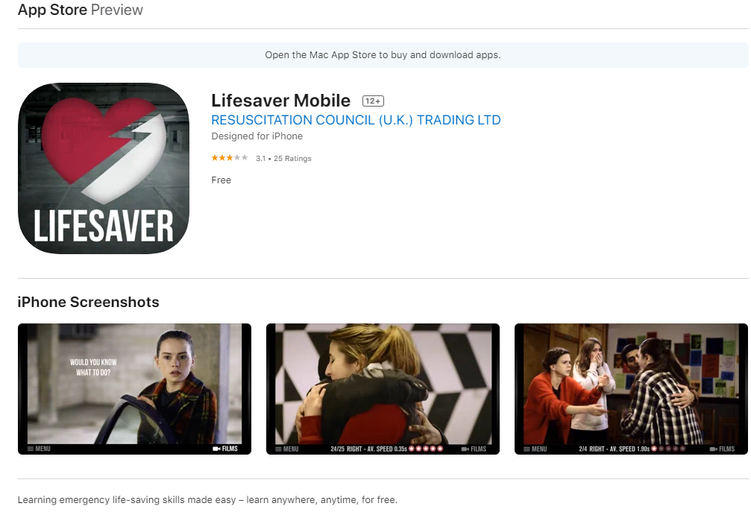
Using your phone
Do your own research and find something that works for you, and you know how to use easily and quickly

Slide 17
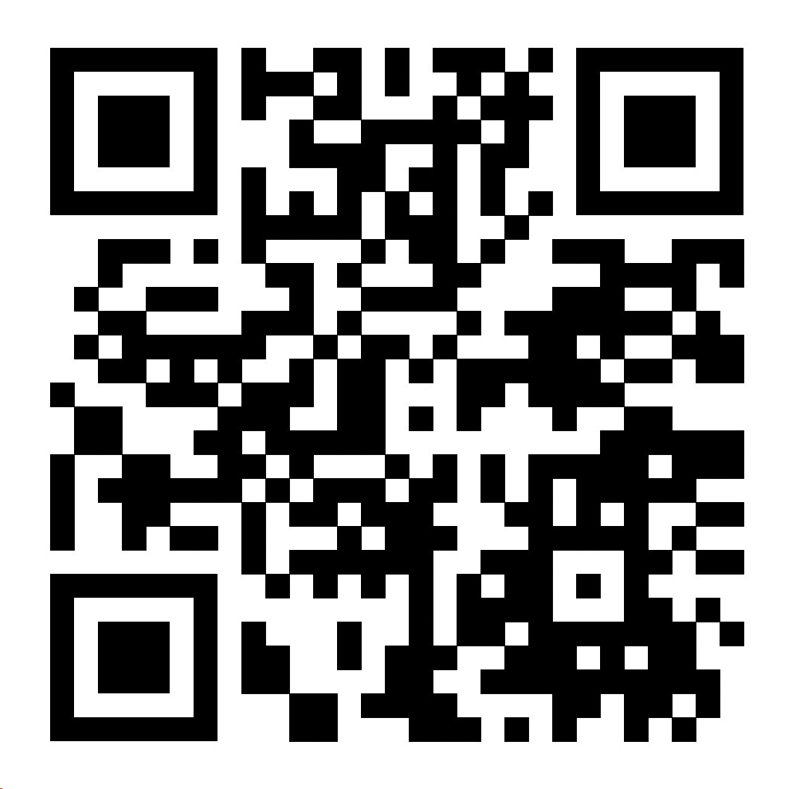
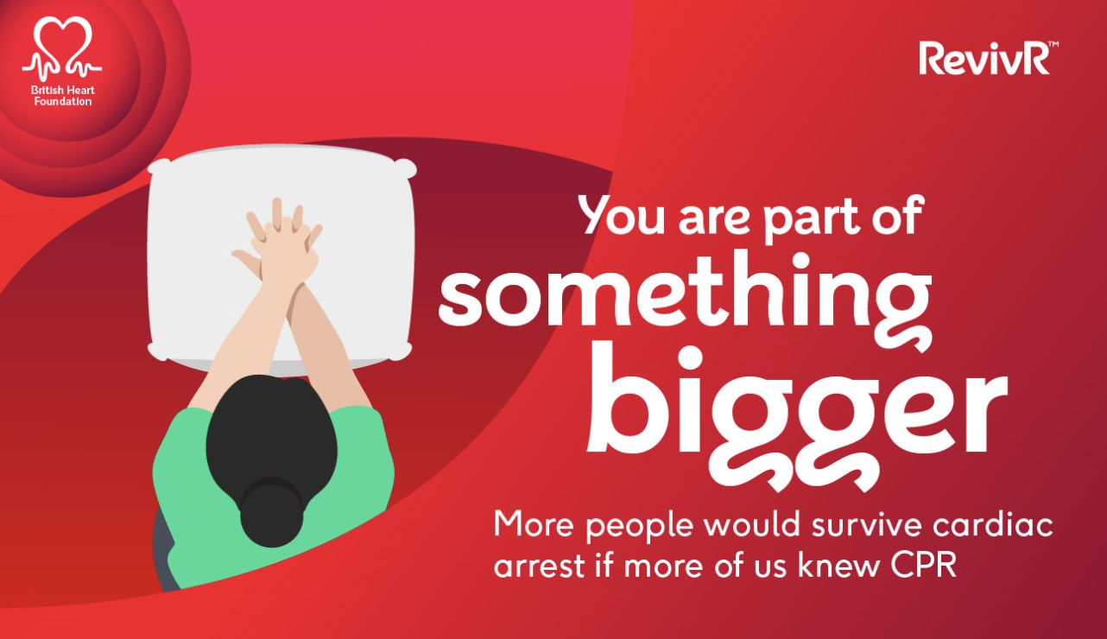
Training – How to Complete this at Home
QR code not working? Google British Heart Foundation RevivR

Slide 18
Thank you

